Slide 1

Objective Methods for Measuring QoE
Jakub Nawała, Mikołaj Leszczuk
Thursday, 6 Dec. 2018
Notes:
This is yet another thing we are doing on a daily basis.
Again, we will be focusing on video-related applications.

Slide 2
From QoS to QoE
QoS
Quality model
QoE
Pixels
Calibration
What we know
What we build
What we want
Notes:
Slide from the previous presentation
Quality model - this is the objective method measuring the QoE

Slide 3
What are Those?
Algorithms using objectively measurable input and providing objectively measurable output
For example: “give me a video and I will tell you what an average end-user thinks about its quality”
You want to replace a human with an algorithm

Slide 4
Why Objective Methods?
Objective - “based on real facts and not influenced by personal beliefs or feelings” (from Cambridge Dictionary)
Cheaper
CPUs are much faster than humans (if it comes to digital images processing)
Scalable
Assessing the quality of multiple sources
Notes:
It is safer to build a business based on something objective.
Cheaper - assessing the quality in non-objective way means contacting your end-users (how many do you have?)
Scalable - currently, in TV head-ends, there are people just sitting and watching everything that goes on-air

Slide 5
Classification
Full Reference
No Reference
Full access to the original content
Computationally intensive
Good for content producers (and modifiers)
No access to the original content
Faster than FR methods
Scalable
Notes:
No Reference (NR):
-> scalable: NR probe can be attached at any point there is access to a video signal
There are also Reduced Reference (RR) and mixed methods, but they are not so popular.

Slide 6
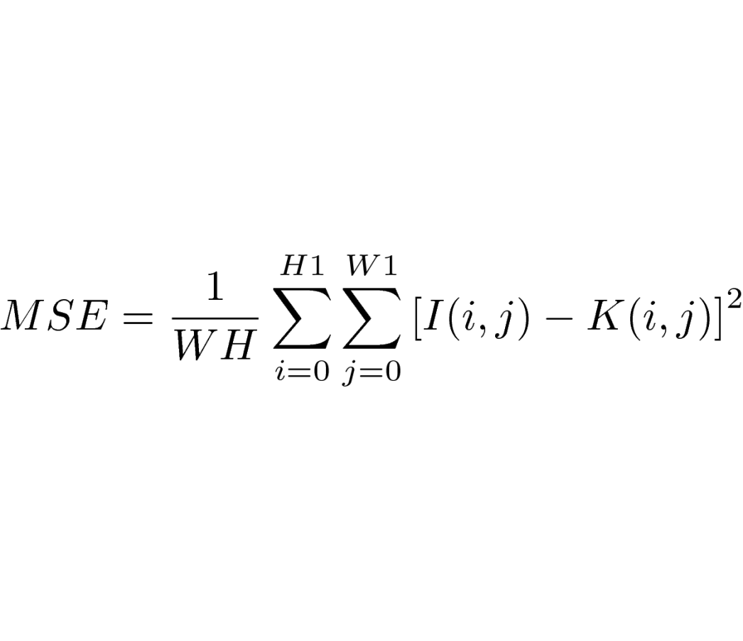
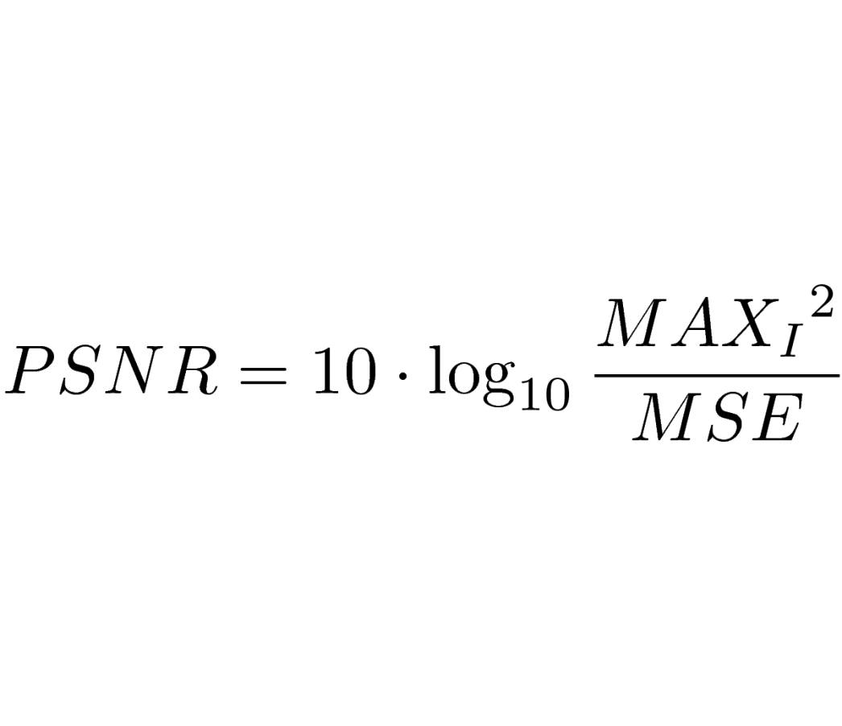
PSNR
Examples
The most popular
Based on Mean Squared Error (MSE) metric
Used in Shot Boundary Detection (SBD)
For details, see here
Full Reference
Notes:
I gave here equations without deep explanation. For details please refer to the laboratory instruction.

Slide 7

VMAF
Examples
Perceptual video quality assessment based on multi-method fusion
State-of-the-art
Created by Netflix, Inc.
Click the Octocat to go to its repository
Full Reference
Notes:
I didn’t use Netflix’s logo, because it is not legal to do so without their prior consent. The story is different if it comes to Octocat that links to GitHub.

Slide 8
Implementation of Key Performance Indicators (KPIs) for Quality Measurement
Examples
No Reference
Notes:
Objective measurement of QoE starts here - present it on Dec, 6 2018
Not only implementation, but also the general description
Special type of quality - subjectively perceived quality

Slide 9

General Information
Algorithmic approach to visual quality assessment:
repeatable
easy to manipulate
countable
implementable
Notes:
Repeatable: more stable than asking people about the quality
Easy to manipulate: possible to map it to other measures, one may look for correlation between various phenomena, in general, application of mathematics is possible!
Countable: good medium for comparison of various visual materials
Implementable: can be (and was) transferred to both software and hardware solutions

Slide 10
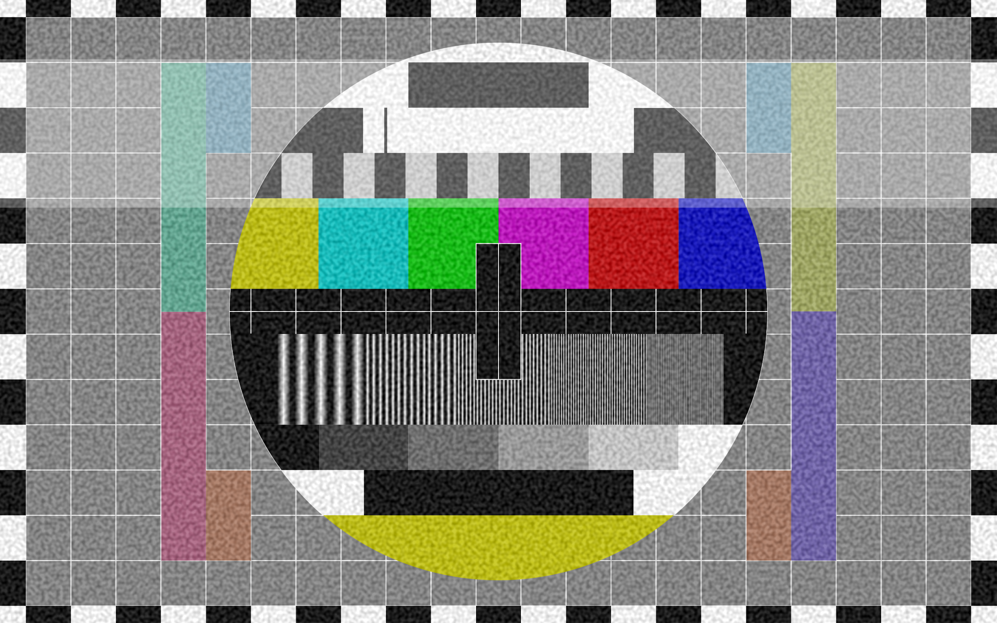
General Information
Measurement targeting many artifact sources:
capturing
processing
transmission
display
Notes:
capturing: optics non-ideality
processing: mainly compression and rescaling
transmission: lossy medium
display: low dynamic range, smaller colour gamut
targeting specific distortions should give higher accuracy

Slide 11

General Information
Results reflecting subjectively perceived quality:
correlation with human perception of visual artifacts
signal-based approach (so called No-Reference approach)
Notes:
KPIs - objective quality measure (any numerical value),
People’s opinion - subjective quality measure (usually Mean Opinion Score)
Non-trivial goal - in practice, one has to run subjective tests
If human perception is the most important, then let’s focus on visual signal and not compression, transmission parameters and so on

Slide 12
No-Reference Approach
Opposite to Full-Reference approach
Easily applicable to many scenarios:
No-Reference probe can be attached at any point of content delivery chain
no need of source material
access to visual content as the only one requirement
Notes:
Full-Reference is a classical approach - take each pixel from unmodified image and compare it with associated pixel in modified image
source material - unmodified, original, high-quality visual content (no compression, no lossy transmission)
One does not need to have knowledge about transmission, compression and display parameters

Slide 13
No-Reference Approach
Non-trivial:
based on Human Visual System (HVS) response to visual artifacts
no information about compression and transmission parameters
no direct way to compare with source material
Notes:
Not everyone has the same sensitivity for visual artifacts
It is not possible to apply simple pixel-to-pixel algorithm comparing modified and unmodified visual material

Slide 14
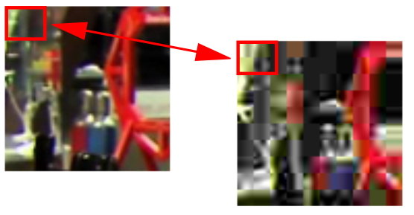
Other Approaches
Full-Reference:
applicable when source material is accessible
usually computationally intensive
good for content producers/modifiers
Notes:
In practice, this approach achieves higher correlation with subjectively perceived quality
Standardised approach used by many important players (e.g., Netflix)
Classical, well-defined

Slide 15
Other Approaches
Reduced-Reference
only some parameters about the source material and its processing are available
Bitstream-based
no need to access visual signal
ongoing development by standardisation parties
Notes:
Bitstream-based:
one wants to say as much as possible about the visual content by looking on the transport layer (but not only)
can be applied at many points of delivery chain
can be used with encrypted signal
modular build: if only transport level - transport level measurements, if more - more

Slide 16
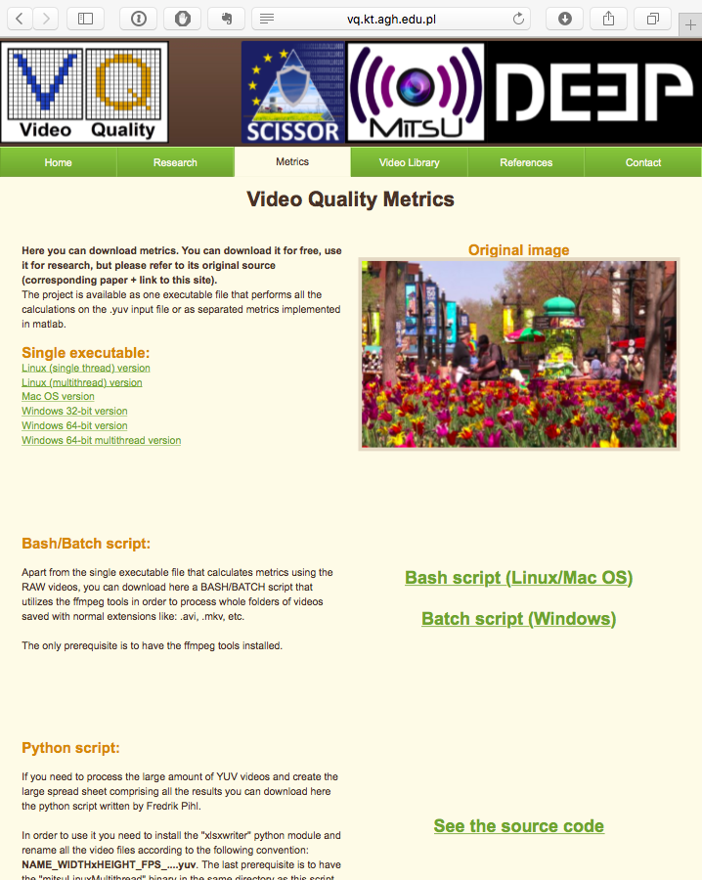
Our Implementation
15 Video Quality Indicators (VQIs)
Implemented in C
Binary executables freely available online at: http://vq.kt.agh.edu.pl/
Source code available for research upon request
Notes:
VQIs is just our name for KPIs
C implementation makes it easy to port the algorithms to various platforms
Tested quite well (e.g., by licensing parties)

Slide 17
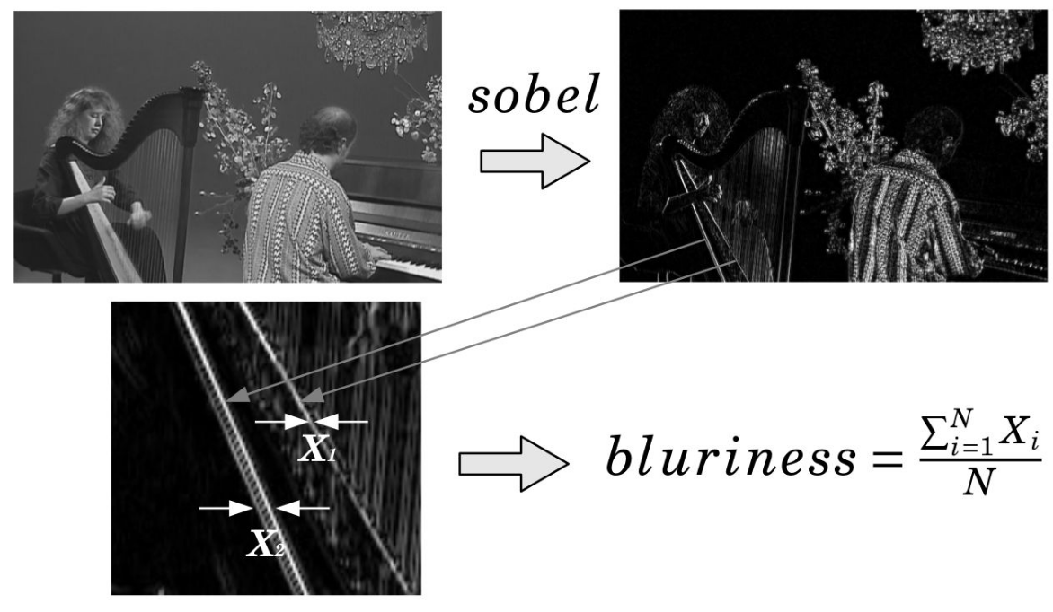
Example: Blur VQI
Notes:
Execution flow:
Read Y channel from YUV image,
Find edges using Sobel filter,
Measure width of edges
Only a subset of existing edges are chosen (based on dynamically calculated threshold value derived from standard deviation for a given macro block)
Result is proportional to mean width of edges

Slide 18
Additional Exercise
Implement your own VQI
Python 3 as the preferred language
No restrictions on libraries used
Deadline: the end of the semester
Notes:
More details are (or will be) provided in the laboratory instruction.

Slide 19
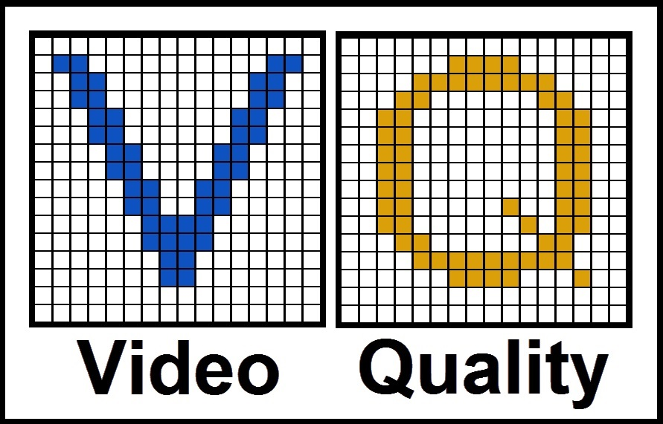
Master Thesis
Topics related to
Data Analysis
Machine Learning
Digital Image Processing
Subjective Testing
QoE
Contact prof. Mikołaj Leszczuk or prof. Lucjan Janowski
Notes:
If you are planning to stay for the 2nd degree studies, please consider making your master thesis with us.
The list of topics is not exhaustive. Mikołaj easily accepts everything related with bicycles and Lucjan is open to VR and AR-related topics.

